Slide 1


Slide 2
New SSIS Features in SQL Server 2016
Hubert Kobierzewski

Slide 3
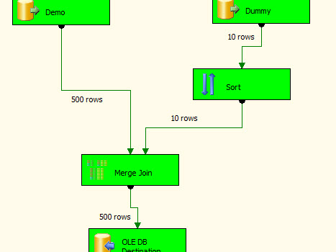
Time for some DEMO

Slide 4
Thank you!
Hubert.Kobierzewski@plssug.org.pl

